Slide 1

Visualization Types by Task Taxonomy
CAP 5738 Data Visualization
Spring 2018
Dr. Sayeed S. Alam

Slide 2
Introduction
Overall, the bandwidth of information presentation is potentially higher in the visual domain than for media reaching any of the other senses.
Humans have remarkable perceptual abilities, that are greatly under utilized in current designs.
Users can scan, recognize, and recall images rapidly, and can detect changes in size, color, shape, movement, or texture.
They can point to a single pixel, even in a megapixel display, and can drag one object to another to perform an action.
User interfaces have been largely text-oriented, so as visual approaches are explored, appealing new opportunities are emerging.

Slide 3
Visual Design Guidelines
There are many visual design guidelines but the basic principle might be: summarized as the Visual Information Seeking Mantra:
Overview first,
zoom and filter,
then details-on-demand

Slide 4
Data Types
1-D
2-D
3-D
Temporal
N-D / Multidimensional
Tree
Network

Slide 5
Seven Tasks
The seven tasks are at a high level of abstraction.
More tasks and refinements of these tasks would be natural next steps in expanding this table.
The seven tasks are:
Overview: Gain an overview of the entire collection.
Zoom : Zoom in on items of interest
Filter: filter out uninteresting items.
Details-on-demand: Select an item or group and get details when needed
Relate: View relationships among items.
History: Keep a history of actions to support undo, replay, and progressive refinement.
Extract: Allow extraction of sub-collections and of the query parameters

Slide 6
1-Dimensional Data Visualization
linear data types include textual documents, program source code, and alphabetical lists of names which are all organized in a sequential manner.
Each item in the collection is a line of text containing a string of characters
Additional line attributes might be the date of last update or author name.
Examples: An early approach to dealing with large 1- dimensional data sets was the bifocal display which provided detailed information in the focus area and less information in the surrounding context area.

Slide 7
2-D/ Planar Data Visualization
Planar or map data include geographic maps, floorplans, or newspaper layouts.
Each item in the collection covers some part of the total area and may be rectangular or not.
Each item has task-domain attributes such as name, owner, value, etc. and interface domain features such as size, color, opacity, etc.
While many systems adopt a multiple layer approach to dealing with map data, each layer is 2-dimensional
Visualizations:
Choropleth Map
Cartogram
Dot Map
Proportion Symbol Map/ Bubble Map

Slide 8
Choropleth Map
Choropleth Maps display divided geographical areas or regions that are colored, shaded or patterned in relation to a data variable.
This provides a way to visualize values over a geographical area, which can show variation or patterns across the displayed location.
One downside to the use of color is that you can't accurately read or compare values from the map.
Another issue is that larger regions appear more emphasized then smaller ones, so the viewer's perception of the shaded values are affected.

Slide 9
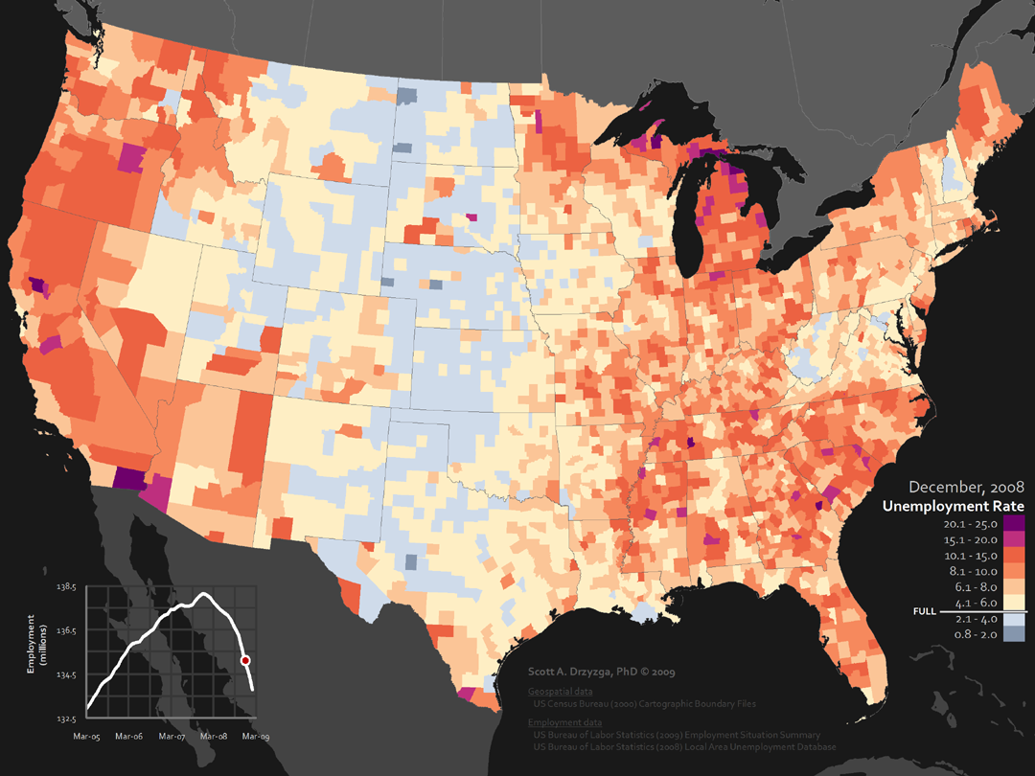
Choropleth Map

Slide 10
Cartogram
An area cartogram is sometimes referred to as a value-by-area map or an iso demographic map.
The shape and relative location of each country is retained to as large an extent as possible, but inevitably a large amount of distortion results.

Slide 11
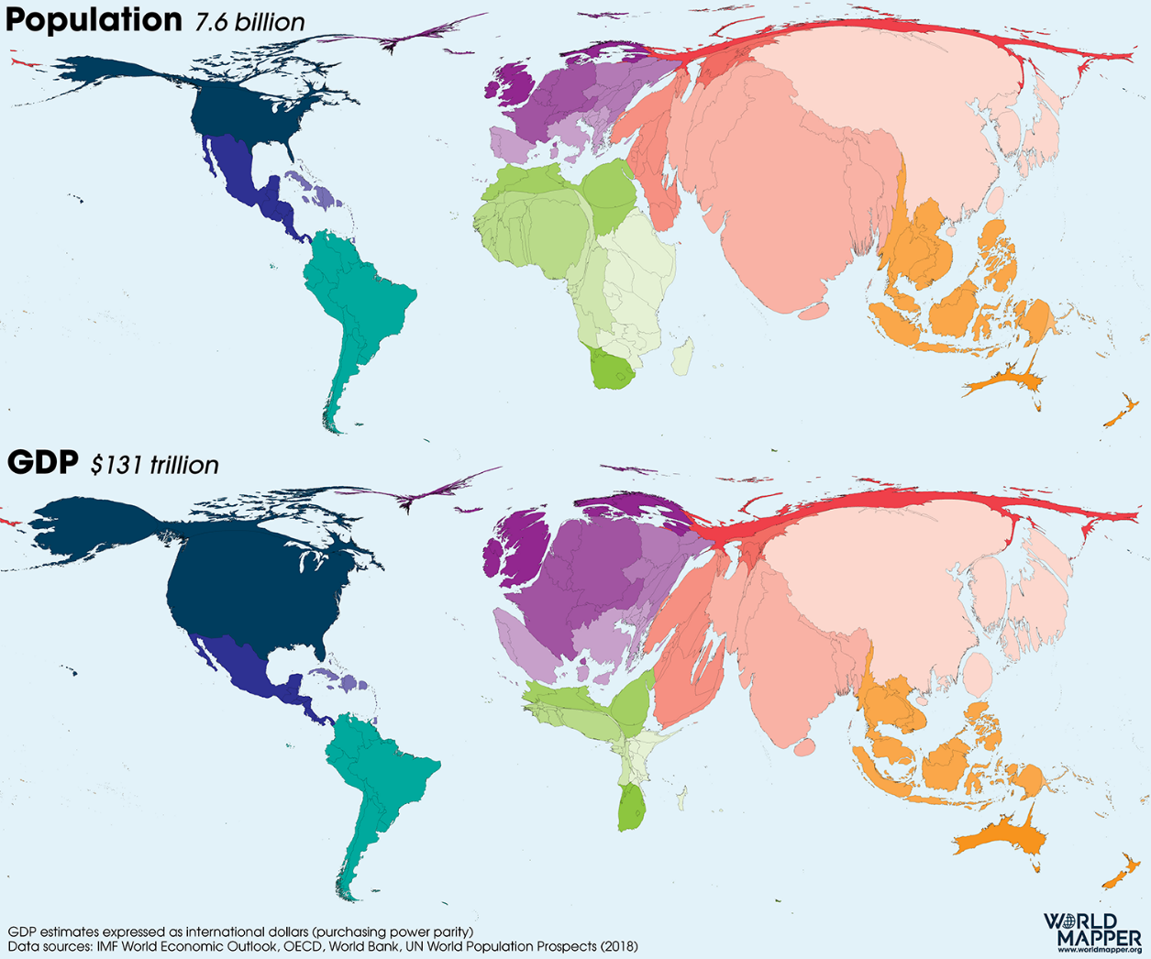

Slide 12
Dot Map
Also known as a Point Map, Dot Distribution Map, Dot Density Map.
Dot Maps are a way of detecting spatial patterns or the distribution of data over a geographical region, by placing equally sized points over a geographical region
Dot Maps are ideal for seeing how things are distributed over a geographical region and can reveal patterns when the points cluster on the map.
Dot Maps are easy to grasp and are better at giving an overview of the data, but are not great for retrieving exact values.

Slide 13
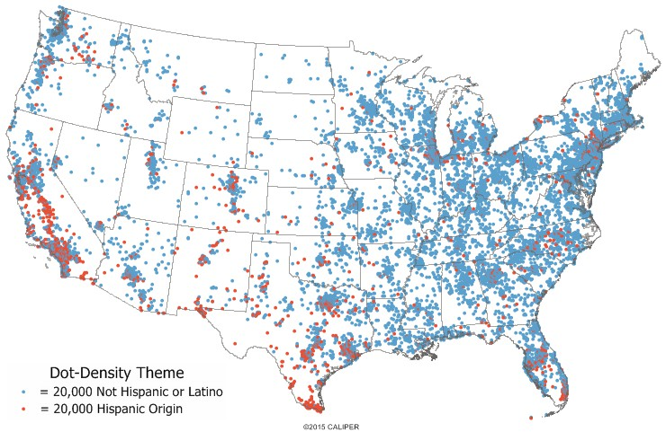
Dot Map

Slide 14
Bubble Map
With this data map, circles are displayed over a designated geographical region with the area of the circle proportional to its value in the dataset.
Bubble Maps are good for comparing proportions over geographic regions without the issues caused by regional area size, as seen on Choropleth Maps.
However, a major flaw with Bubble Maps is that overly large bubbles can overlap other bubbles and regions on the map, so this needs to be accounted for.

Slide 15
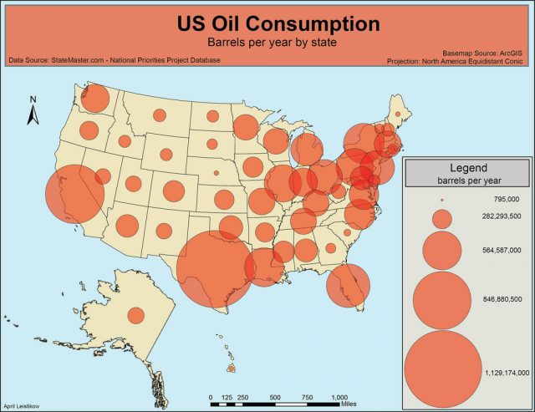

Slide 16
Other 2-D map visualizations
Contour Maps
Dasymetric Maps
Self-organizing Map

Slide 17
3-Dimensional Data Visualization
Real-world objects such as molecules, the human body, and buildings have items with volume and some potentially complex relationship with other items.
Computer-assisted design systems for architects, solid modelers, and mechanical engineers are built to handle complex 3-dimensional relationships.
In 3-dimensional applications users must cope with understanding their position and orientation when viewing the objects, plus the serious problems of occlusion.
Solutions to some of these problems are proposed in many prototypes with techniques such as overviews, landmarks, perspective, stereo display, transparency, and color coding.
Examples: 3D computer models, surface and volume rendering, computer simulations

Slide 18
Temporal
Time lines are widely used and vital enough for medical records, project management, or historical presentations to create a data type that is separate from 1-dimensional data.
The distinction in temporal data is that items have a start and finish time and that items may overlap.
Frequent tasks include finding all events before, after, or during some time period or moment, plus the basic tasks
Visualizations:
Timeline
Time series, Connected Scatter plot, Gantt Chart
Theme River/Steam graph
Arc Diagram

Slide 19
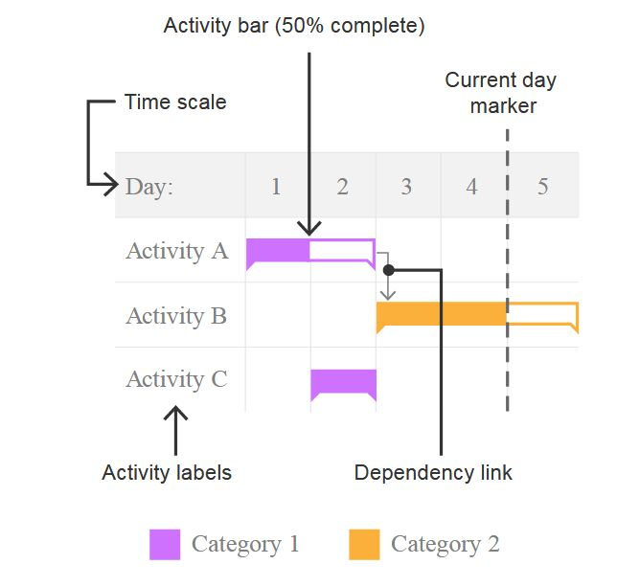
Gantt Chart
Commonly used as an organizational tool for project management, Gantt Charts display a list of activities (or tasks) with their duration over time, showing when each activity starts and ends.
This makes Gantt Charts useful for planning and estimating how long an entire project might take. You can also see what activities are running in parallel to each other.

Slide 20
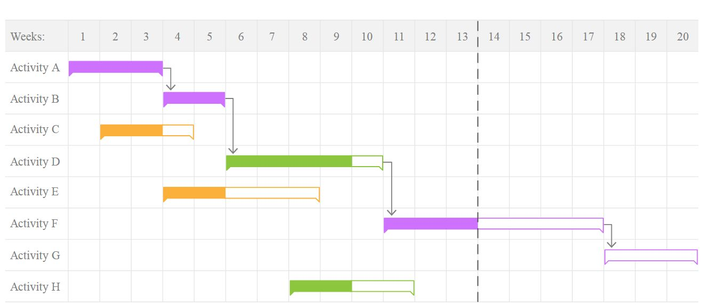
Gantt Chart

Slide 21
Theme River/Steam graph
This type of visualization is a variation of a Stacked Area Graph, but instead of plotting values against a fixed, straight axis, a Stream Graph has values displaced around a varying central baseline.
Stream Graphs display the changes in data over time of different categories through the use of flowing, organic shapes that somewhat resemble a river-like stream.
This makes Stream Graphs aesthetically pleasing and more engaging to look at.
Stream Graphs are ideal for displaying high-volume datasets, in order to discover trends and patterns over time across a wide range of categories.
The downside to Stream Graphs is that they suffer from legibility issues, as they are often very cluttered with large datasets.

Slide 22
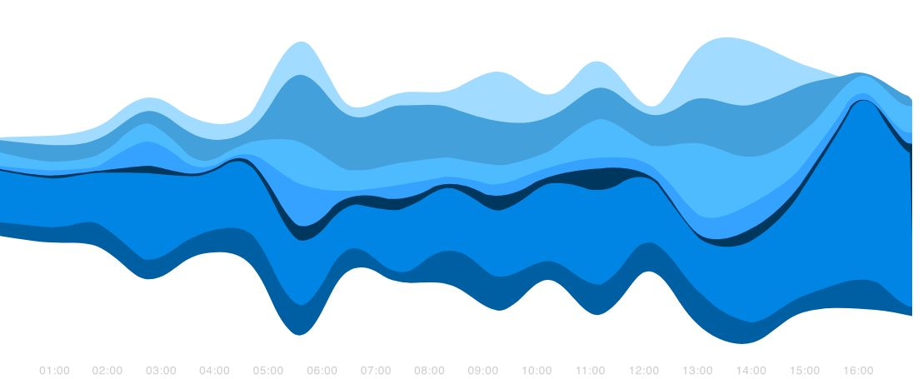
Theme River/Steam graph

Slide 23
Arc Diagram
Arc Diagrams are an alternate way of representing two- dimensional Network Diagrams.
In Arc Diagrams, nodes are placed along a single line (a one-dimensional axis) and arcs are used to show connections between those nodes.
The downside to Arc Diagrams is they don't show structure and connections between nodes as well as 2D charts do and too many links can make the diagram hard to read due to clutter.

Slide 24
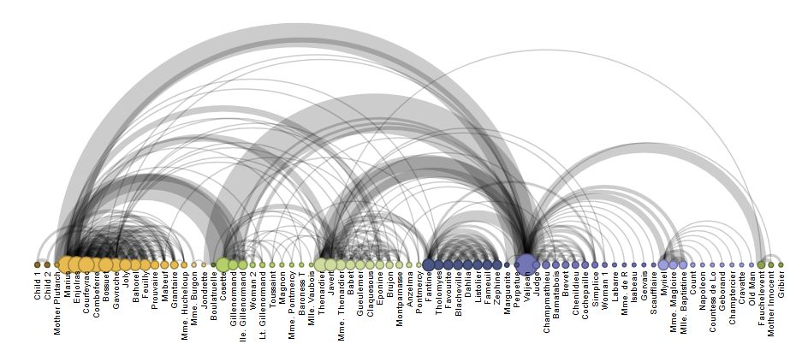
Arc Diagram

Slide 25
Sankey Diagram
Sankey Diagrams display flows and their quantities in proportion to one another.
The width of the arrows or lines are used to show their magnitudes, so the bigger the arrow, the larger the quantity of flow.
Flow arrows or lines can combine together or split through their paths on each stage of a process.
Color can be used to divide the diagram into different categories or to show the transition from one state of the process to another.
Typically, Sankey Diagrams are used to visually show the transfer of energy, money or materials, but they can be used to show the flow of any isolated system process.

Slide 26
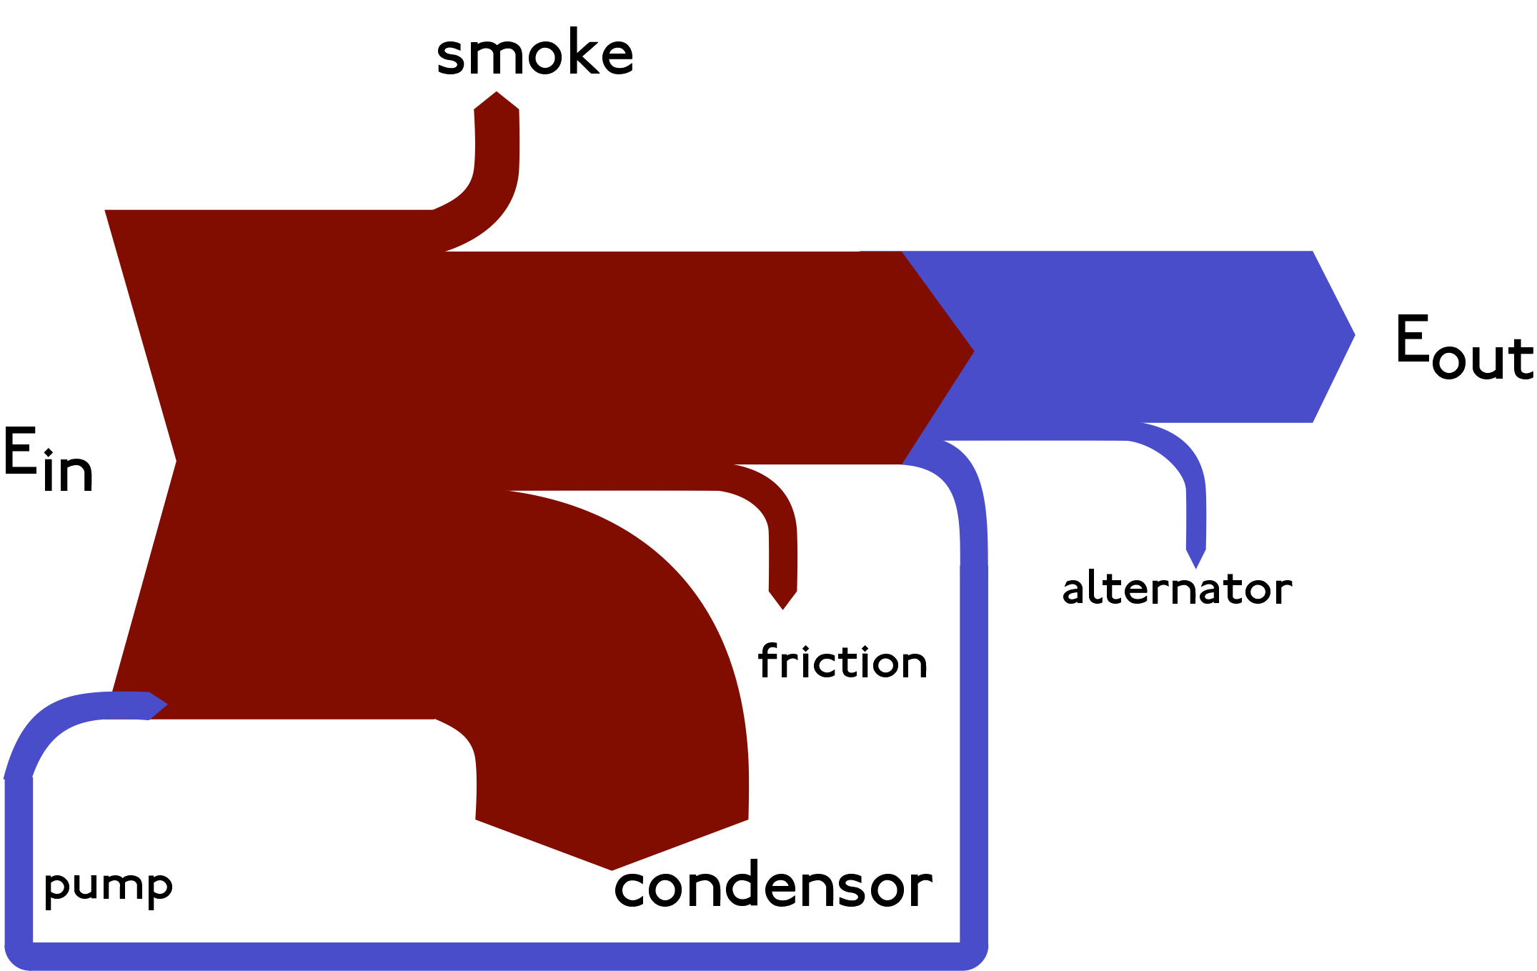
Sankey : Thermodynamic Steam Cycle

Slide 27
N-D/Multidimensional Data Visualization
Most relational and statistical databases are conveniently manipulated as multidimensional data in which items with n attributes become points in a n-dimensional space.
Visualizations:
Pie Chart
Histogram
Tag Cloud
Parallel Coordinates
Radial Chart
Stacked Area Graph

Slide 28
Pie Chart
Extensively used in presentations and offices, Pie Charts help show proportions and percentages between categories, by dividing a circle into proportional segments.
Each arc length represents a proportion of each category, while the full circle represents the total sum of all the data, equal to 100%.
Pie Charts are ideal for giving the reader a quick idea of the proportional distribution of the data. However the major downsides to pie charts are:
They cannot show more then a few values, because as the number of values shown increases, the size of each segment/slice becomes smaller. This makes them unsuitable for large amounts of data.
They take up more space then their alternatives, like a 100% Stacked Bar Chart for example. Mainly due to their size and for the usual need for a legend.
They are not great for making accurate comparisons between groups of Pie Charts. This being that it is harder to distinguish the size of items via area when it is for length.

Slide 29
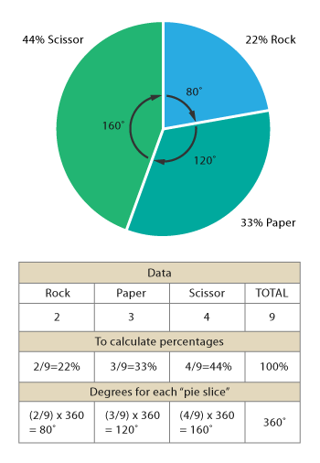
Pie Chart

Slide 30
Histogram
A Histogram visualizes the distribution of data over a continuous interval or certain time period.
Each bar in a histogram represents the tabulated frequency at each interval/bin.
Histograms help give an estimate as to where values are concentrated, what the extremes are and whether there are any gaps or unusual values.
They are also useful for giving a rough view of the probability distribution.

Slide 31
Histogram
A Histogram visualizes the distribution of data over a continuous interval or certain time period.
Each bar in a histogram represents the tabulated frequency at each interval/bin.
Histograms help give an estimate as to where values are concentrated, what the extremes are and whether there are any gaps or unusual values.
They are also useful for giving a rough view of the probability distribution.

Slide 32
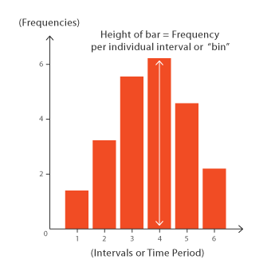
Histogram

Slide 33
Word/Tag Cloud
A visualization method that displays how frequently words appear in a given body of text, by making the size of each word proportional to its frequency.
All the words are then arranged in a cluster or cloud of words. Alternatively, the words can also be arranged in any format: horizontal lines, columns or within a shape.
Although being simple and easy to understand, Word Clouds have some major flaws:
Long words are emphasized over short words.
Words whose letters contain many ascenders and descenders may receive more attention.
They're not great for analytical accuracy, so used more for aesthetic reasons instead.

Slide 34
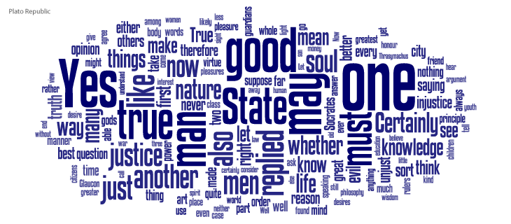
Word/Tag Cloud

Slide 35




Parallel Coordinates Plot
This type of visualisation is used for plotting multivariate, numerical data. Parallel Coordinates Plots are ideal for comparing many variables together and seeing the relationships between them.
For example, if you had to compare an array of products with the same attributes (comparing computer or cars specs across different models).
The downside to Parallel Coordinates Plots, is that they can become over-cluttered and therefore, illegible when they’re very data-dense.
The best way to remedy this problem is through interactivity and a technique known as “Brushing”.
Brushing highlights a selected line or collection of lines while fading out all the others. This allows you to isolate sections of the plot you’re interested in while filtering out the noise.

Slide 36
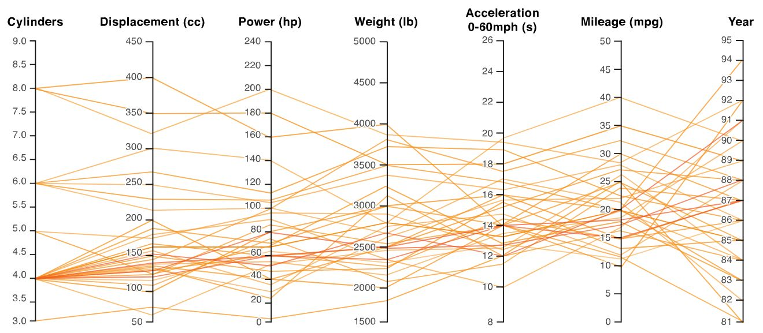
Parallel Coordinates Plot

Slide 37
Heatmap
Heatmaps visualise data through variations in coloring.
When applied to a tabular format, Heatmaps are useful for cross-examining multivariate data, through placing variables in the rows and columns and coloring the cells within the table.
Heatmaps are good for showing variance across multiple variables, revealing any patterns, displaying whether any variables are similar to each other, and for detecting if any correlations exist in-between them.
Because of their reliance on colour to communicate values, Heatmaps are a chart better suited to displaying a more generalised view of numerical data, as it’s harder to accurately tell the differences between colour shades and to extract specific data points from (unless of course, you include the raw data in the cells).

Slide 38
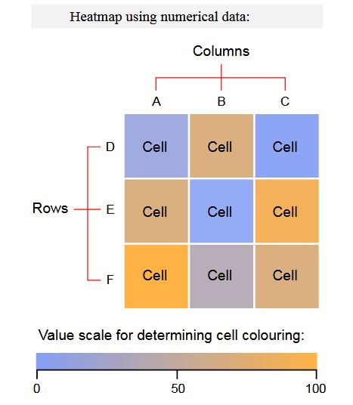
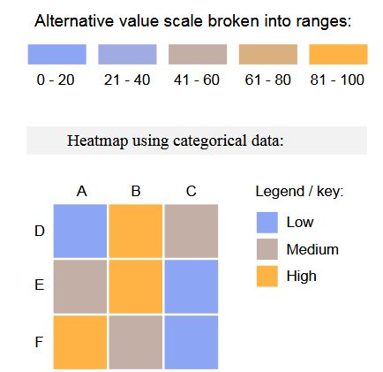
Heatmap

Slide 39
Radar Chart
As known as: Spider Chart, Web Chart, Polar Chart, Star Plots.
Radar Charts are a way of comparing multiple quantitative variables.
This makes them useful for seeing which variables have similar values or if there are any outliers amongst each variable.
Radar Charts are also useful for seeing which variables are scoring high or low within a dataset, making them ideal for displaying performance.
However, there are some major flaws with Radar Charts:
Having multiple polygons in one Radar Chart makes it hard to read, confusing and too cluttered. Especially if the polygons are filled in, as the top polygon covers all the other polygons underneath it.
Having too many variables creates too many axes and can also make the chart hard to read and complicated. So it's good practice to keep Radar Charts simple and limit the number of variables used.

Slide 40
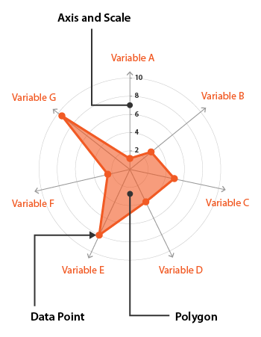
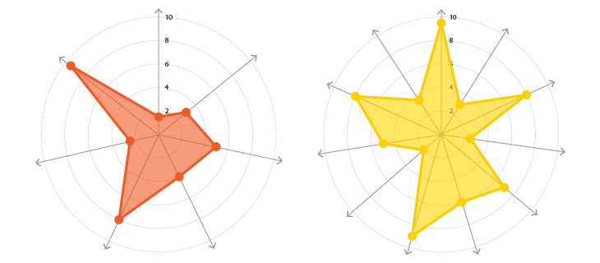
Radar Chart

Slide 41
Stacked Area Graph
Stacked Area Graphs work in the same way as simple Area Graphs do, except for the use of multiple data series that start each point from the point left by the previous data series.
The entire graph represents the total of all the data plotted. Stacked Area Graphs also use the areas to convey whole numbers, so they do not work for negative values.
Overall, they are useful for comparing multiple variables changing over an interval.

Slide 42
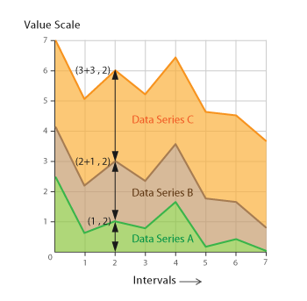
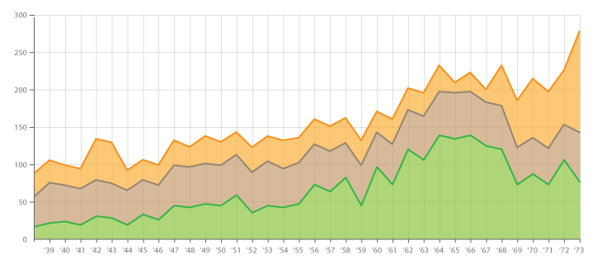
Stacked Area Graph

Slide 43
Tree Data Visualizations
Hierarchies or tree structures are collections of items with each item having a link to one parent item (except the root)
Items and the links between parent and child can have multiple attributes.

Slide 44
Tree Diagram
A Tree Diagram is a way of visually representing hierarchy in a tree-like structure.
Typically the structure of a Tree Diagram consists of elements such as a root node, a member that has no superior/parent.
Tree Diagrams are often used:
To show family relations and descent.
In taxonomy, the practice and science of classification.
In evolutionary science, to show the origin of species.
In computer science and mathematics.
In businesses and organisations for managerial purposes. used:

Slide 45
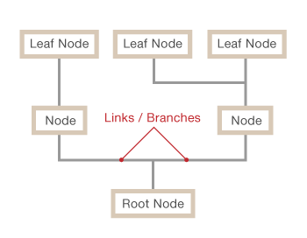
Tree Diagram

Slide 46
Dendogram
A dendrogram (from Greek dendro "tree" and gramma "drawing") is a tree diagram frequently used to illustrate the arrangement of the clusters produced by hierarchical clustering.
Dendrograms are often used in computational biology to illustrate the clustering of genes or samples, sometimes on top of heatmaps.

Slide 47
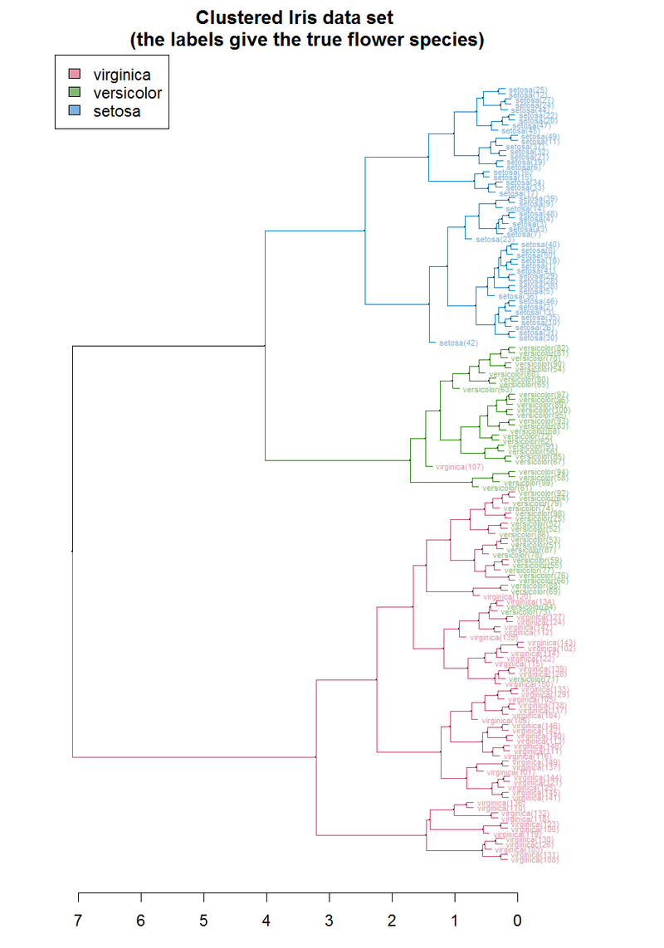
Dendogram

Slide 48
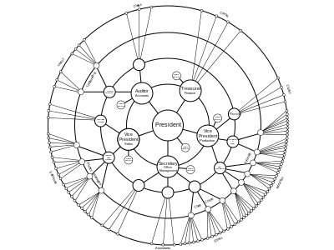
Radial Tree
A radial tree, or radial map, is a method of displaying a tree structure (e.g., a tree data structure) in a way that expands outwards, radially.
It is one of many ways to visually display a tree. In use, it is a type of information graphic.

Slide 49
Hyperbolic Tree
A hyperbolic tree (often shortened as hypertree) is an information visualization and graph drawing method inspired by hyperbolic geometry.
Displaying hierarchical data as a tree suffers from visual clutter as the number of nodes per level can grow exponentially. For a simple binary tree, the maximum number of nodes at a level n is 2^{n}, while the number of nodes for larger trees grows much more quickly.
Drawing the tree as a node-link diagram thus requires exponential amounts of space to be displayed.

Slide 50
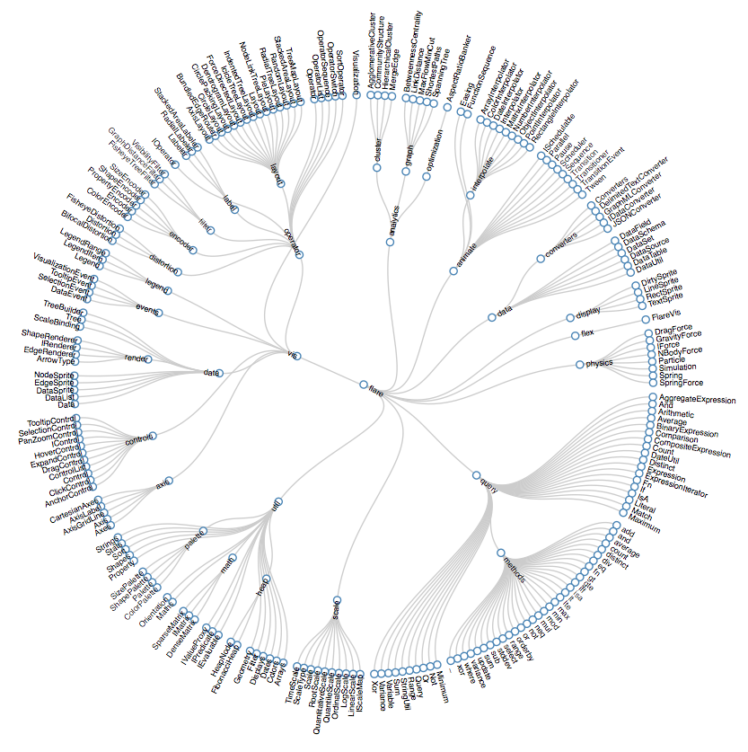
Hyperbolic Tree

Slide 51
Treemap
Treemaps are an alternative way of visualizing the hierarchical structure of a Tree Diagram while also displaying quantities for each category via area size.
Each category is assigned a rectangle area with their subcategory rectangles nested inside of it.
When a quantity is assigned to a category, its area size is displayed in proportion to that quantity and to the other quantities within the same parent category in a part-to-whole relationship.
Also, the area size of the parent category is the total of its subcategories.
If no quantity is assigned to a subcategory, then it's area is divided equally amongst the other subcategories within its parent category

Slide 52
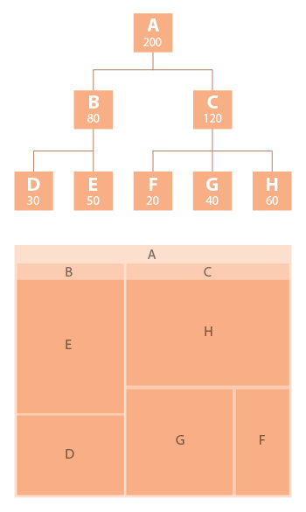
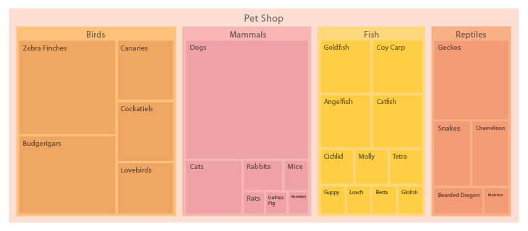
Treemap

Slide 53
Sunburst Diagram
As known as a Sunburst Chart, Ring Chart, Multi-level Pie Chart, Belt Chart, Radial Treemap.
This type of visualization shows hierarchy through a series of rings, that are sliced for each category node. Each ring corresponds to a level in the hierarchy, with the central circle representing the root node and the hierarchy moving outwards from it.
Rings are sliced up and divided based on their hierarchical relationship to the parent slice. The angle of each slice is either divided equally under its parent node or can be made proportional to a value.
Colour can be used to highlight hierarchal groupings or specific categories

Slide 54
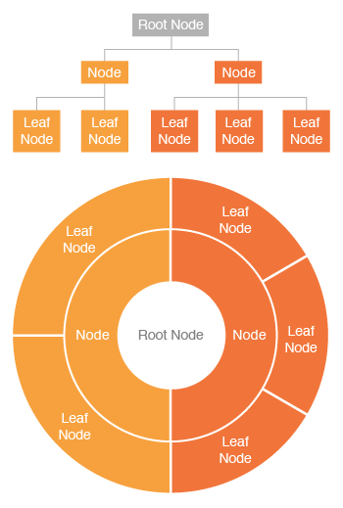
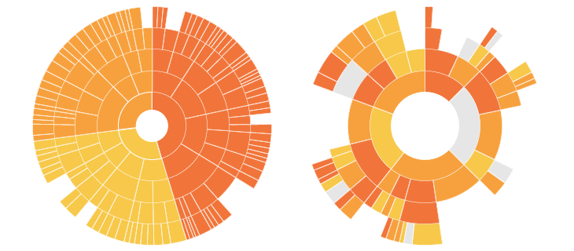
Sunburst Diagram

Slide 55
Network Data Visualizations
Sometimes relationships among items cannot be conveniently captured with a tree structure and it is useful to have items linked to an arbitrary number of other items.
While many special cases of networks exist (acyclic, lattices, rooted vs. un-rooted, directed vs undirected) it seems convenient to consider them all as one data type.
In addition to the basic tasks applied to items and links, network users often want to know about shortest or least mostly paths connecting two items or traversing the entire network.
Interface representations include a node and link diagram, and a square matrix of the items with the value of a link attribute in the row and column representing a link.

Slide 56
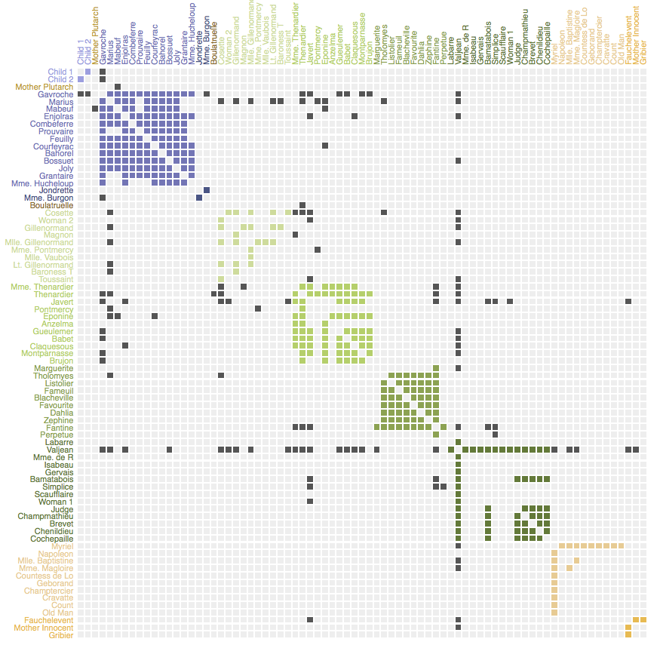
Matrix

Slide 57
Node-link Diagram
Also known as Network Graph, Network Map, Node-Link Diagram.
This type of visualization shows how things are interconnected through the use of nodes / vertices and link lines to represent their connections and help illuminate the type of relationships between a group of entities.
By mapping out connected systems, Network Diagrams can be used to interpret the structure of a network through looking for any clustering of the nodes, how densely nodes are connected or by how the diagram layout is arranged.
Network Diagrams have a limited data capacity and start to become hard to read when there are too many nodes and resemble "hairballs".

Slide 58
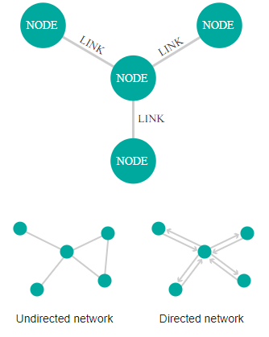
Node-link Diagram

Slide 59
Alluvial Diagram
Alluvial diagrams are a type of flow diagram originally developed to represent changes in network structure over time.
In allusion to both their visual appearance and their emphasis on flow, alluvial diagrams are named after alluvial fans that are naturally formed by the soil deposited from streaming water.

Slide 60
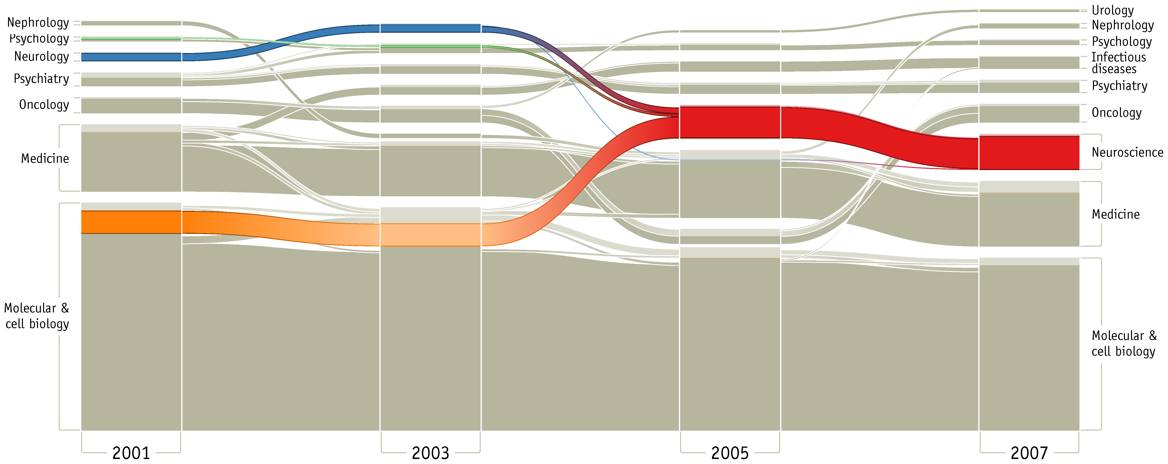
Alluvial Diagram

Slide 61
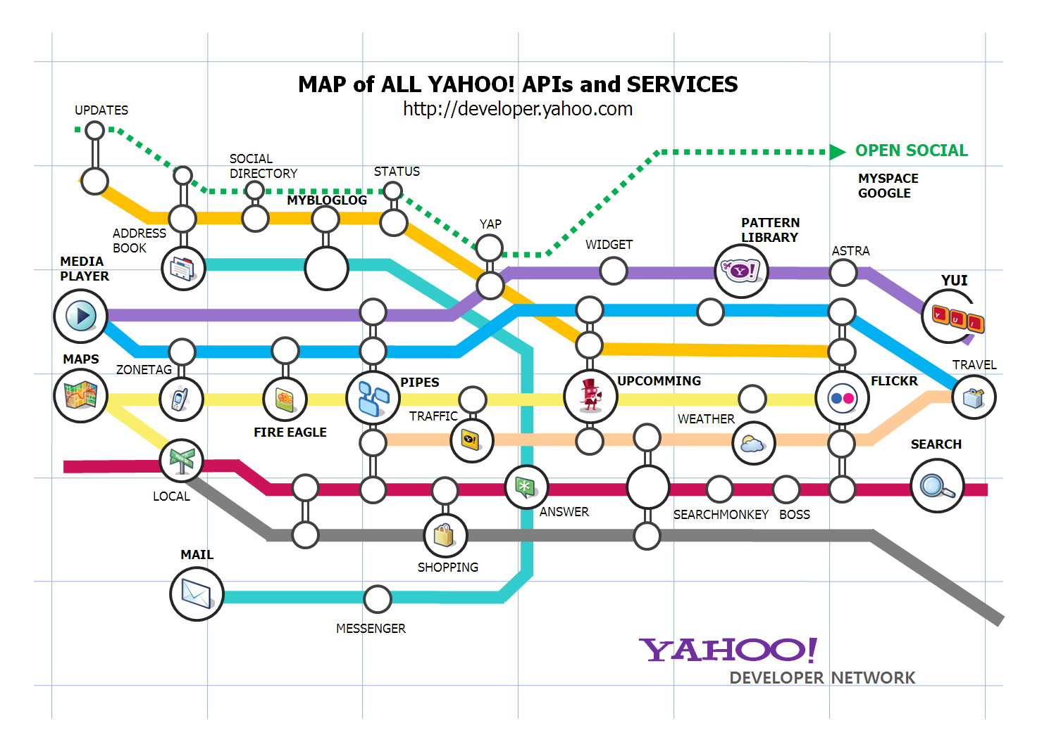
Subway/tube map

Slide 62
Conclusion
Novel graphical and direct-manipulation approaches to query formulation and information visualization are now possible.
While research prototypes have typically dealt with only one data type (1-, 2-, 3-dimensional data, temporal and multidimensional data, and tree and network data), successful commercial products will have to accommodate several.
These products will need to provide smooth integration with existing software and support the full task list: Overview, zoom, filter, details-on-demand, relate, history, and extract. These ideas are attractive because they present information rapidly and allow for rapid user-controlled exploration.
If they are to be fully effective, some of these approaches require novel data structures, high-resolution color displays, fast data retrieval, specialized data structures, parallel computation, and some user training.

Slide 63
References
Shneiderman, Ben. "The eyes have it: A task by data type taxonomy for information visualizations." The Craft of Information Visualization. 2003. 364-371.
https://guides.library.duke.edu/datavis/vis_types
https://datavizcatalogue.com/index.html

Slide 64
Thank You

